Slide 1

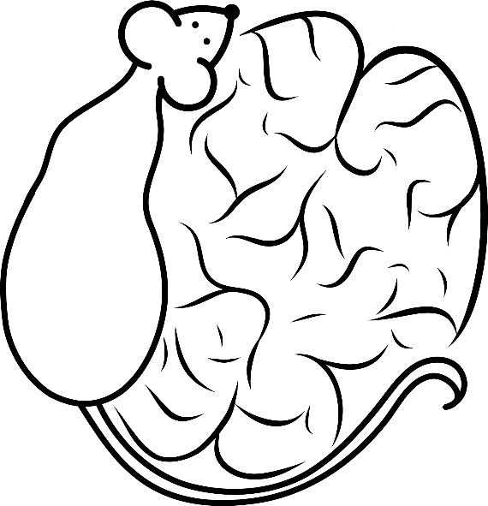

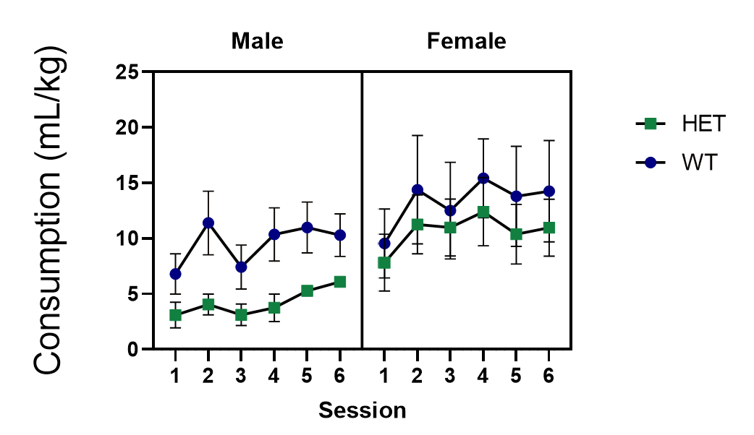
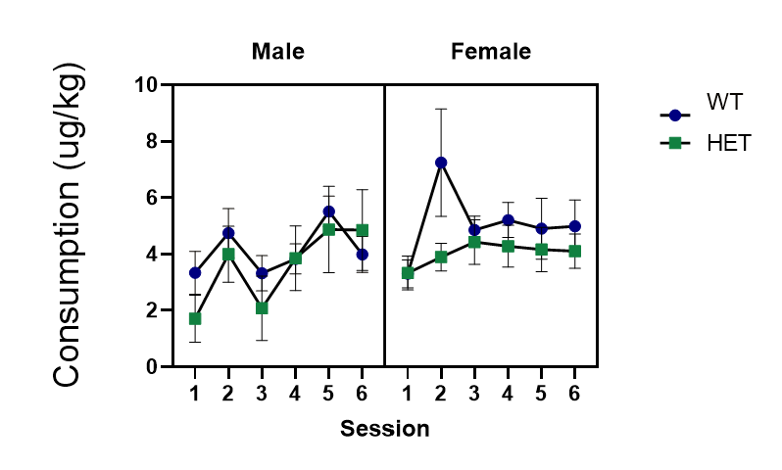
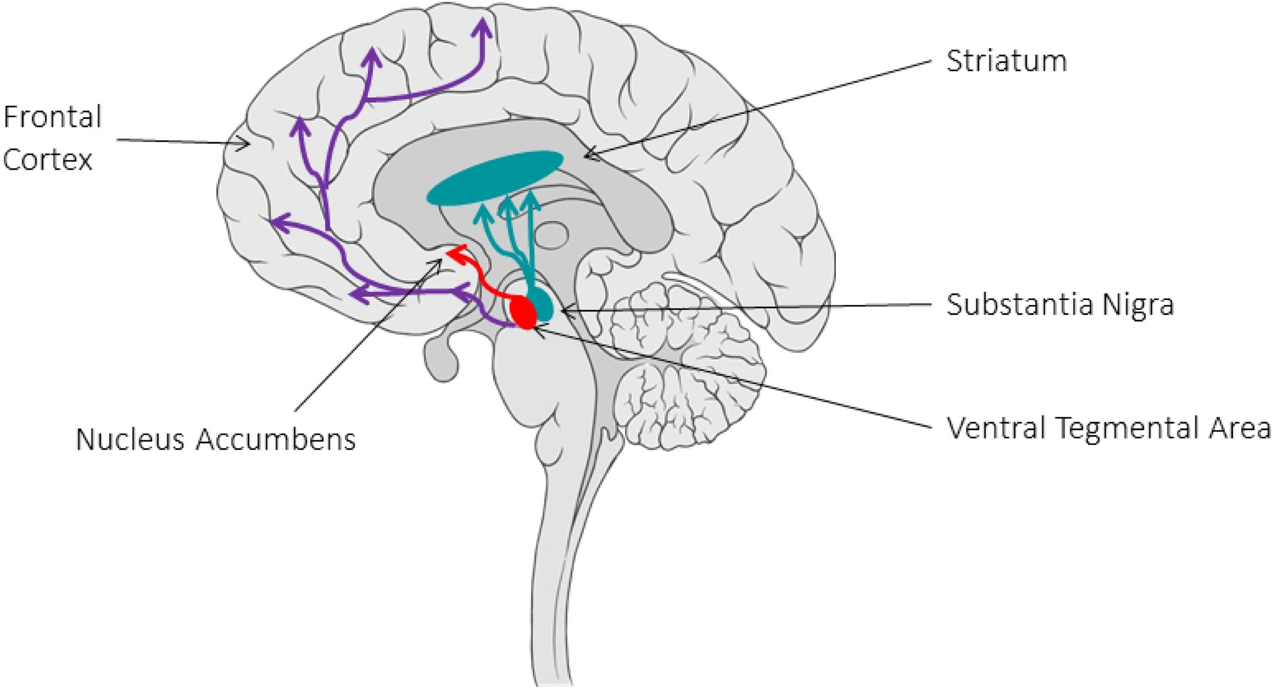
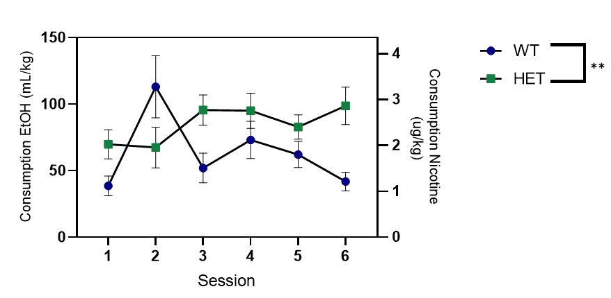
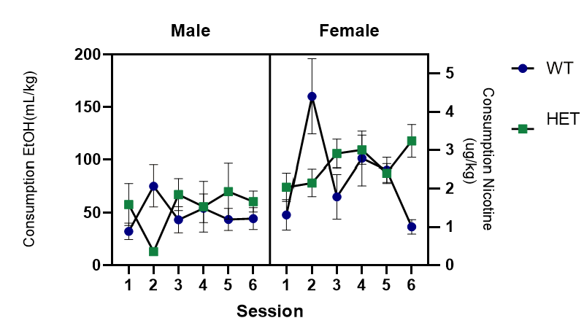
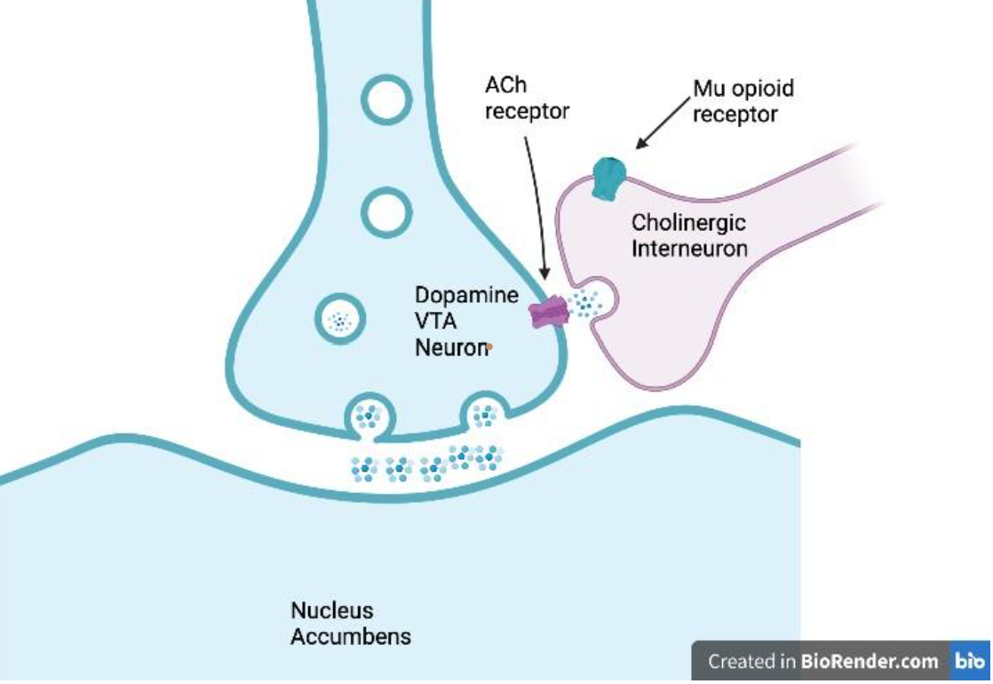
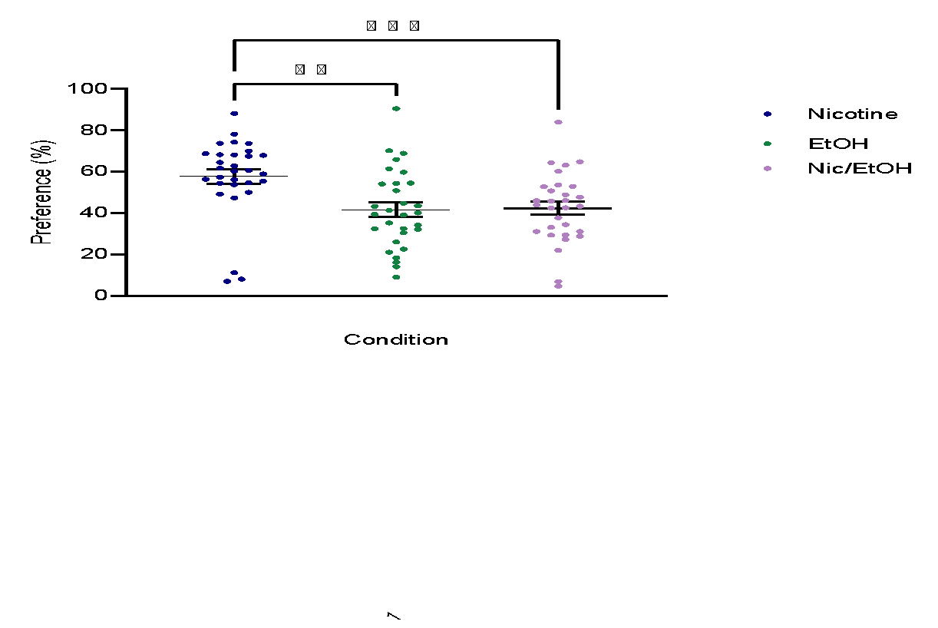
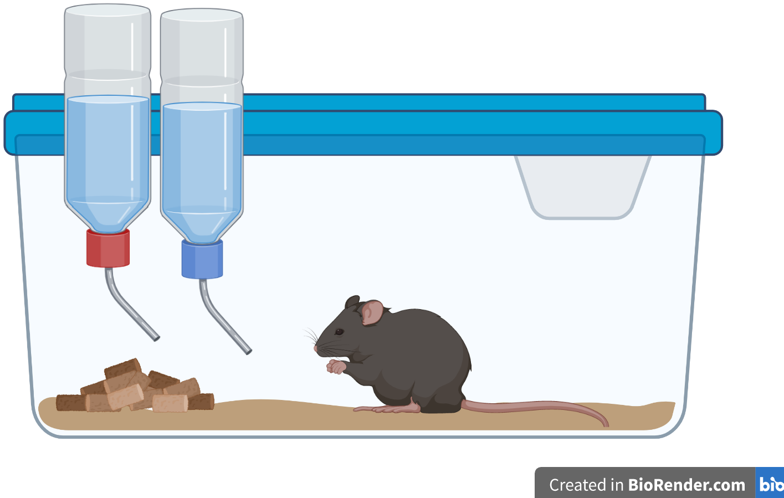
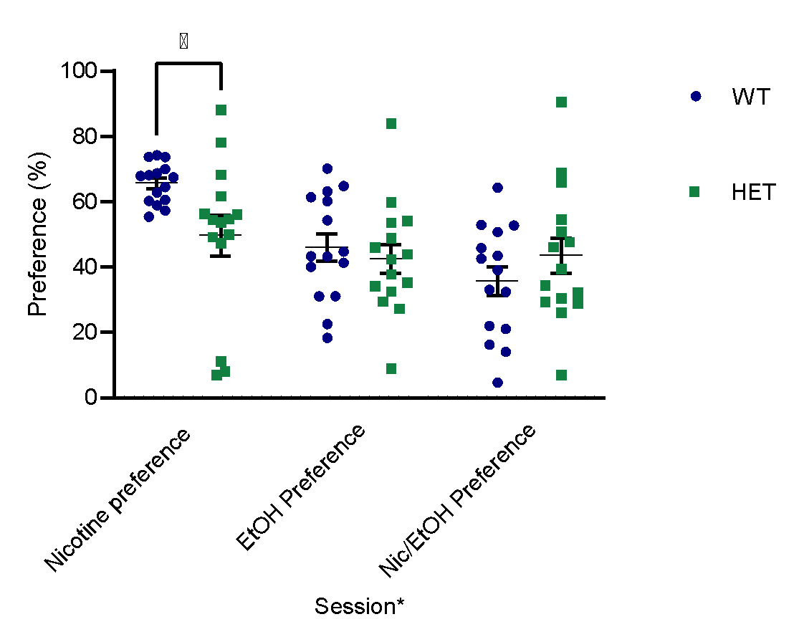
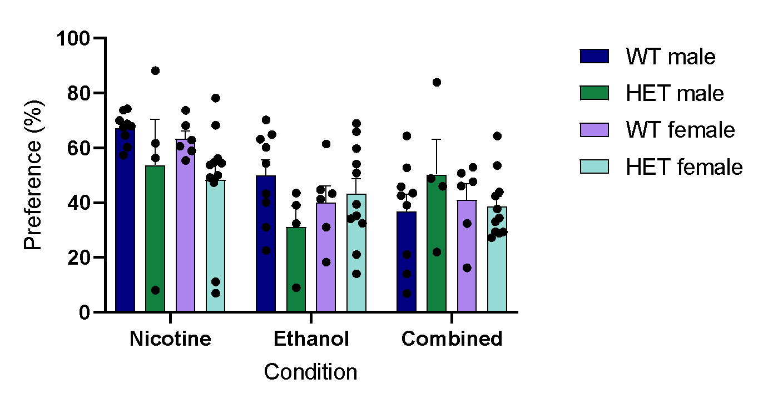
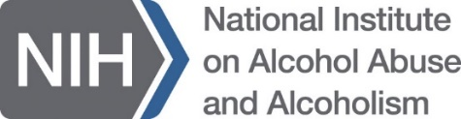
Impact of Nicotine and Alcohol Individually and Concurrently
in ChAT-MOR Knockout Mice
Mary Durfee, Kat Pikus, Delainey Lewis, Nicolaus Bruns VI, and Anna K. Radke
Department of Psychology, Miami University, Oxford, OH, USA
Broadening
Undergraduate
Research
Participation
Introduction
Alcohol and nicotine are common substances that impact individuals individually and concurrently.
      16.2 million adults in 2021 reported heavy drinking in the past month¹.
      61.6 million people 12 and up in 2021 reported using tobacco products or vaping nicotine in the past 30 days²
      An estimated 70-80% of alcohol users also smoke³.
This project investigates the impact of nicotine and alcohol in ChAT-MOR mice.
ChAT-MOR mice have a knockout on the mu-opioid receptors (MOR) on acetylcholine producing neurons – primarily located in the striatum.
Figure 8. Major dopaminergic pathways in the brain. Nigrostriatal in blue,
mesolimbic in red, and mesocortical in purple. Retrieved from sciencedirect.com⁴.
Our goal was to investigate the relationship between these cholinergic interneurons (CIN), the dopaminergic pathways, and addiction.
Both nicotine and alcohol have been shown to influence the mesolimbic dopamine system
CINs within the Ventral Tegmental Area release acetylcholine onto dopamine neurons and regulate dopamine release.
Results
Big Findings
● Significant consumption based on session in all conditions (regardless of order or genotype)
All conditions significantly changed based on previous experience with the drug regardless of sex and genotype
● Significant nicotine preference compared to other conditions (regardless of order or genotype)
Nicotine was the preferred substance compared to all other substances
● This study was not powered to detect sex differences, but female mice tended to consume more than males
Effect of genotype on ethanol consumption may be sex-dependent
● Genetic deletion of MOR on CINs increased consumption of nicotine/ethanol only.
CINs, likely through regulation of dopamine release, may contribute differently to usage of different substances
● This research justifies the need for future studies into the role of mu-opioid receptors on the cholinergic interneurons in substance use.
Mice consumed significantly different EtOH amounts depending on the session
Nicotine consumption produces session dependent effect
Figure 1. Consumption in mL EtOH per kg body weight of mice. Each session reflects a 24-hour drinking period.
Main effect session (F(3.519, 90.79)=4.653) P=0.0028 (3-way ANOVA).
Mice tended to consume more EtOH during later sessions than the earlier sessions.
Figure 3. Combined nicotine solution consumption measured in ug nicotine salt per kg body weight during 24-hour drinking periods.
Main effect session (F(3.315,85.53)=3.951) P= 0.0087 (Mixed effects).
Mice tend to consume nicotine in different amounts depending on the session.
Heterozygous mice consume significantly more Nicotine/ EtOH than Wild-type mice
Heterozygous mice consumed significantly higher amounts of the combined solution
Future Steps
Investigate sex differences
Investigate age differences
Replication of this study unchanged
Lengthen the time frame of each condition
Use different concentrations of each substance
Add a rewarding substance to the substances like sucrose
Figure 2. Combined nicotine and ethanol mixture during six 24-hour drinking sessions. Total ethanol consumption is measured in mL ethanol per kg of body weight. Total nicotine consumption is measured in ug nicotine salt per kg of body weight.
Main effect genotype (F(1,138)=7.844) P=0.0058. Main effect session by genotype (F(5,138)= 2.546) P=0.0308 (3-way ANOVA).
Combined solution consumption was dependent on genotype, with heterozygous mice consuming more solution than wild-type mice. Additionally, the impact of the effect of genotype on drinking was affected by the session.
Figure 4. Ethanol and nicotine combined solution consumption. EtOH reported in mL of ethanol in mixture per kg of body weight. Nicotine reported in ug nicotine salt in mixture per kg of body weight. Each session is a 24-hour drinking period.
Combined Nicotine and EtOH consumption creates a genotype specific effect. Main effect genotype (F(1,26)=10.83) P=0.0029 (3 way mixed-effect).
There is not significant evidence of a difference in sex but there is a trend in consumption.
Methods
Subjects: C57BL/6J male and female mice were generated from breeding pairs purchased from The Jackson Laboratory, Bar Harbor, ME.
30 adult mice: 15 ChAT-MOR knockout and 15 wild-type
            ■ 17 Female, 13 Male
  ■ 6 WT female, 9 WT male; 11 HET female, 4 HET male
  Statistically powered for genotype
    ■ Not powered for sex
  Solutions:
  Nicotine solutions were 30 µg/mL (nicotine salt to water)
  Ethanol solutions were 20% v/v (ethanol to water)
    ■ Bottle position switched cage sides to control for side preference.
    Paradigm:
  24-hour intermittent access 2-bottle choice
  ■ 2 water bottles on each cage
  - On days: 1 water, 1 solution for 24 hours
  - Off days: 2 water for 24 hours
  ■ On and off days induce withdrawal feelings
  and encourages increased drinking
  Timeline:
  Data Analysis:
  Data was collected and stored using Microsoft Excel
  Data was analyzed using GraphPad Prism
Mice have a significantly higher preference for nicotine compared to all other drug solutions
Figure 5. Preference is reported as the amount of substance consumed out of total liquid consumed during drinking period. Reported as a percentage.
Main effect condition P= 0.0015 R-square=0.2244. Tukey’s multiple comparisons test Nicotine vs. EtOH P= 0.0076, Nicotine vs. combined Nicotine/EtOH P=0.0001
The mice drank significantly more nicotine than either of the other two conditions.
Wild-type mice have a significantly higher preference for nicotine than heterozygous mice
References
1. SAMHSA, Center for Behavioral Health Statistics and Quality. 2021 National Survey on Drug Use and Health. Table 2.29A—Heavy alcohol use in past month: among people aged 12 or older; by age group and demographic characteristics, numbers in thousands, 2021. [cited 2023 Jan 11]. Available from: https://www.samhsa.gov/data/sites/default/files/reports/rpt39441/NSDUHDetailedTabs2021/NSDUHDetailedTabs2021/NSDUHDetTabsSect2pe2021.htm#tab2.29a
2. National Survey on Drug Use and Health 2021 (NSDUH-2021-DS0001) | SAMHDA. (n.d.). https://www.datafiles.samhsa.gov/dataset/national-survey-drug-use-and-health-2021-nsduh-2021-ds0001
3. Falk, D., Yi, H. Y., & Hiller-Sturmhöfel, S. (2008). An epidemiologic analysis of co-occurring alcohol and drug use and disorders: findings from the National Epidemiologic Survey of Alcohol and Related Conditions (NESARC). Alcohol research & health : the journal of the National Institute on Alcohol Abuse and Alcoholism, 31(2), 100–110.
4. Reneman, L., van der Pluijm, M., Schrantee, A., &amp; van de Giessen, E. (2021). Imaging of the dopamine system with focus on pharmacological MRI and neuromelanin imaging. [Image]. European Journal of Radiology, 140. https://doi.org/10.1016/j.ejrad.2021.109752
Sex, condition, and genotype impacted solution preference
Weeks | Mice #1-15 | Mice #16-30
1-2 | Water; Water | Water; Water
3-4 | Water; EtOH | Water; Nic
5-6 | Water; Nic | Water; EtOH
7-8 | Water; EtOH + Nic | Water; EtOH + Nic
Acknowledgements
Research supported by the Department of Psychology, the Broadening Undergraduate Research Participation Program at Miami University, and by the National Institute on Alcohol Abuse and Alcoholism.
We personally thank Roman Zegarelli, Thomas Perry, Kiara Ream, Cambria Beane, and Dr. Anna Radke for their guidance and assistance throughout this study.
Figure 6. Comparison of nicotine, ethanol, and combined solution preferences (%) by sex and genotype.
Main effect condition (F (1.931, 50.20) = 13.61) P= <0.0001. Interaction between condition and genotype (F (2, 52) = 3.763) P = .029. Interaction between condition, sex, and genotype (F 2, 52) = 3.385) P = .041. (3-way ANOVA)
Mice had significantly different preferences for each solution. Their preferences for the solutions were affected by their genotype. Additionally, preference for solution was affected by genotype as well as sex
Figure 7. Nicotine, ethanol and combined solution consumption as percent of total liquid consumption.
Main effect of Condition (F (2, 56) = 14.17) P < .0001. Interaction between condition and genotype (F (2, 56) = 5.714 P = 0.0055 (2-way ANOVA)
When it comes to the nicotine consumption, wild-type mice significantly prefer nicotine solution compared to other solution types.

